Slide 1


CAPSTONE PROJECT II
DATA ANALYSIS
ALFIAN JCDSVL 005 013

Slide 2
PROJECT – REQUIREMENT
1. EXP. VIDEO (25%)
4. DATA VISUALIZATION (25%)
EXPLAIN THE DATA & PROBLEM TO BE ANALYED
HOW THE QUESTION IS ANSWERED
THE ANSWER CAN SOLVE THE PROBLEM ?
CODE USING JUPYTER NOTEBOOK
CAN USE TABLEAU OR PYTHON FOR DAT. VIZ
WHY USING THE TOOLS YOU’RE USING
INSIGHT / STORY / ANY INFORMATION TO EXPLAIN THE GRAPH TO SOLVE THE PROBLEM
2. SQL (20%)
5. STATISTICS (15%)
SQL TO PYTHON CONNECTION
USING CTE OR OTHER WINDOW FUNCTION (IF NEEDED)
BUILT – IN FUNCTION AS NEEDED
COMPARING VALUE / PROPORTION WITH SUITABLE METHOD
RELATIONSHIP BETWEEN FOCUS ANALYSIS WITH OTHER VARIABELS
INSIGHT FROM DESCRIPTIVE STATISTIC TEST & INFERENTIAL STATISTIC TO SOLVE THE PROBLEM
3. DATA MANIPULATION (15%)
ANY ANOMALIES ? (MISSING VALUE, OUTLIER, DATA FORMATTING, DOUBLE DATA ?
HOW TO DEAL WITH THE ANOMALIES ?
IF THERE’S NO ANOMALIES, PROVE IT
6. ETC
FOCUS ANALYSIS : ORDERS (NORTHWIND DB)
DEADLINE : 4th APRIL 2021 (Purwadhika Ops.)

Slide 3

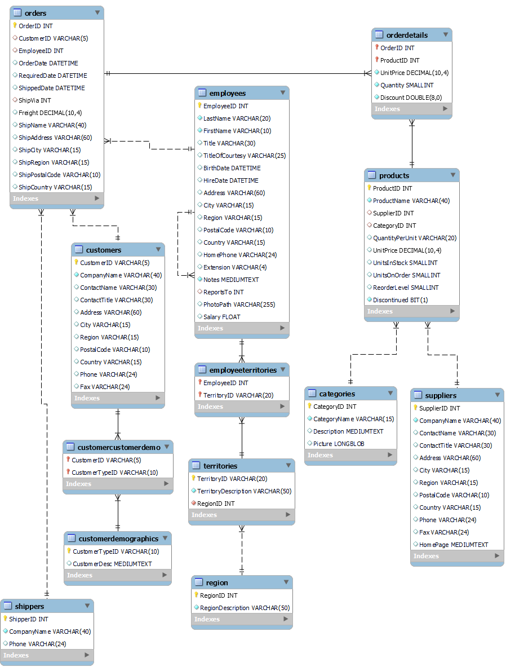




DATABASE – NORTHWIND DATABASE
#1
#3
#2
#1
ORDERS
#4
#2
EMPLOYEES
#3
ORDER DETAILS
#4
CUSTOMERS
#5
SHIPPERS
Employee Territories
Territories
Region
Products
Categories
Suppliers
Customercustomerdemo
customerdemographics
#5

Slide 4
DETAIL PROJECT – PROJECT COMPONENT
GENERAL INFORMATION
Context, explaining database, table relationship, library that will be used in this project
SQL
Connecting SQL to python, Joining multiple table and make dataframe that will be used in the entire project, CTE & Window function
DATA MANIPULATION
Data manipulation will be encountered in every section of Data Insight, but this section we want to check for data anomalies & fix it and clean the data.
DATA INSIGHT
Insight that you can get from data using data visualizaiton and statistic. In this section, graphs will be generated using python visualization tools only.
Part 1 – Product
Part 2 – Date Analysis
Part 3 – Customer Analysis
Part 4 – Expedition Services

Slide 5
TERIMA KASIH
CAPSTONE PROJECT II
DATA ANALYSIS
ALFIAN JCDSVL 005 013

